Slide 1
3-Stage Procedure Design for Selecting a Best Population
Yu Wang
November 30, 2016

Slide 2
Introduction
This 3-stage design is based on two research papers—Subset selection procedure, and Traditional 2-stage selection and testing designs. Since we have learned these two procedures, we want to combine them and test whether the three stage procedure can give a bigger power than two stage procedure. Since after the subset selection, we have the bigger probability to get the best population, so the overall power may become bigger. But when we compare with the two stage procedure, we will fix the power and compare whether the expected sample size for the three stage procedure will be smaller than the two stage procedure.

Slide 3
Overview
Introduction
Selection Procedure for Three Stage
Statistical Formulas
Results and Discussion

Slide 4
Review

Slide 5
Review

Slide 6
3-Stage Procedure:S1

Slide 7
3-Stage Procedure: S2

Slide 8
3-Stage Procedure: S3

Slide 9
3-Stage Procedure: S3

Slide 10
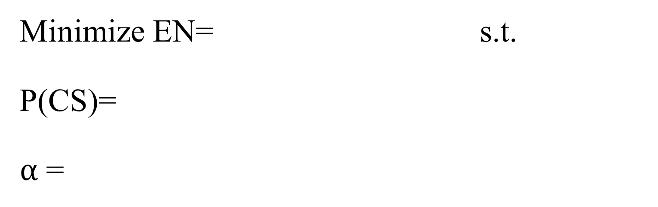
Minimize EN= s.t. P(CS)= $α$ =
Notes:
Now base on the procedures we design for this three stage, we are ready to build up the formulas that will later be used for numerical analysis. So very similar with the 2-stage design, we need to minimize the sample size subject to the constraints of power and alpha level. In the following ill claim my formula for each of them with proof.

Slide 11
Minimize EN= s.t. P(CS)= $α$ =

Slide 12
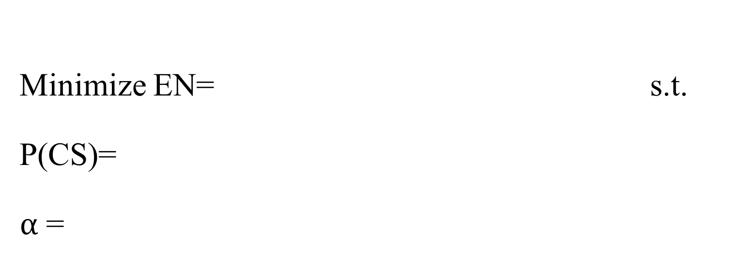
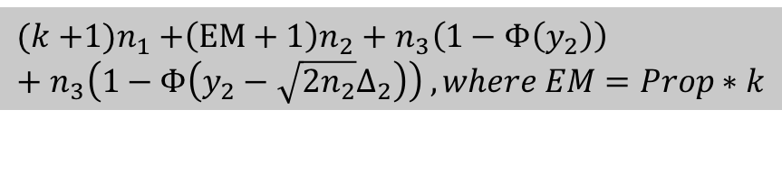
Minimize EN= s.t. P(CS)= $α$ =
$$(k{+1)n}_{1}+\left(EM+1\right)n_{2}+n_{3}\left(1−Φ（y_{2}）\right)+n_{3}\left(1−Φ（y_{2}−{\sqrt{2n_{2}}∆}_{2}）\right) , where EM=Prop∗k$$

Slide 13
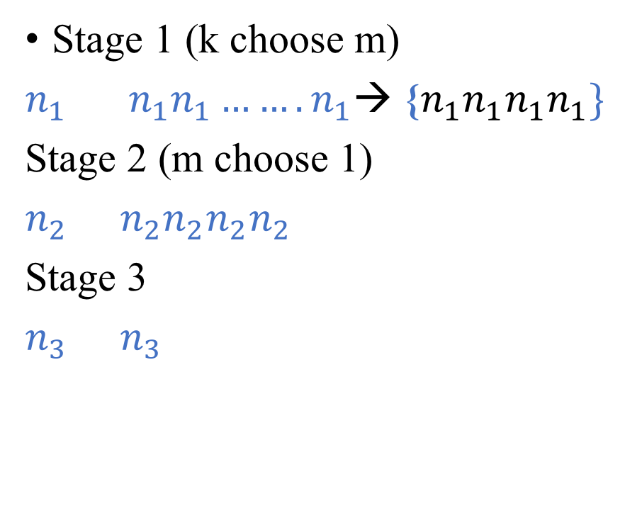
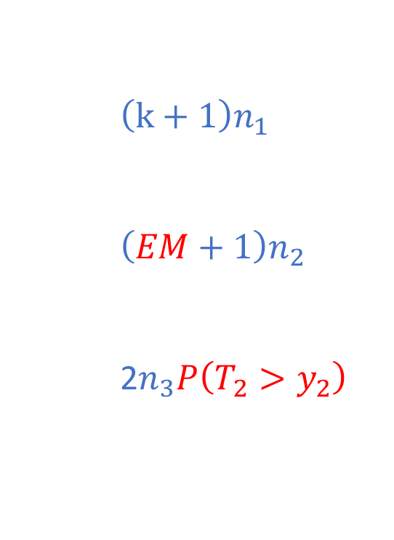
$$(k{+1)n}_{1}+\left(EM+1\right)n_{2}+n_{3}\left(1−Φ（y_{2}）\right)+n_{3}\left(1−Φ（y_{2}−{\sqrt{2n_{2}}∆}_{2}）\right)$$
EN=
$$\left(k+1\right)n_{1}$$
$$\left(EM+1\right)n_{2}$$
2$n_{3}P\left(T_{2}>y_{2}\right)$
Stage 1 (k choose m)
| |||||||→ ||||
Stage 2 (m choose 1)
| ||||
Stage 3
| |
Stage 1 (k choose m)
$n_{1}$ $n_{1}n_{1}…….n_{1}$→ {$n_{1}n_{1}n_{1}n_{1}\}$
Stage 2 (m choose 1)
$n_{2}$ $n_{2}n_{2}n_{2}n_{2}$
Stage 3
$n_{3}$ $n_{3}$
T2 > y2
T2 > y2
T3 > y3
T3 > y3
Claim v is the “best”
Claim v is the “best”
Notes:
Now take a look at what is going on in each of the stage:…
So lets deal with this part first

Slide 14
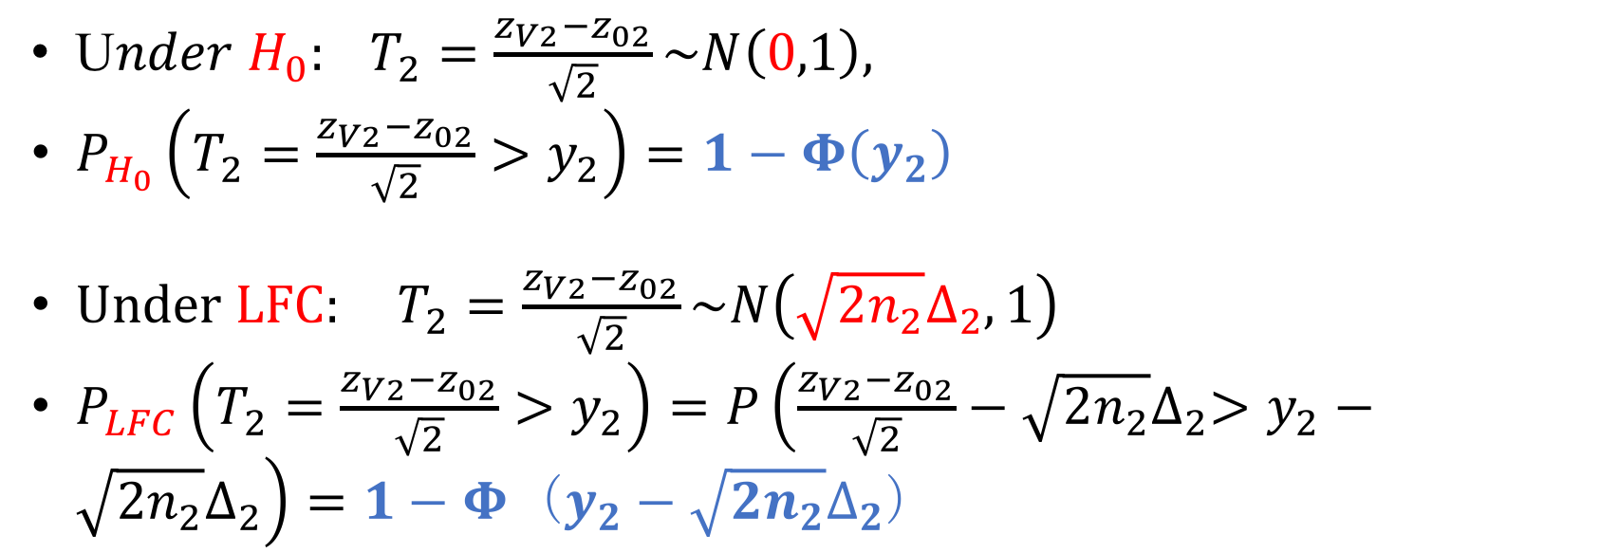
U$nder{ H}_{0}: T_{2}=\frac{z_{V2}−z_{02}}{\sqrt{2}}\sim N\left(0,1\right),$
$P_{H_{0}}\left(T_{2}=\frac{z_{V2}−z_{02}}{\sqrt{2}}>y_{2}\right)=1−Φ（y_{2}）$
$Under LFC: T_{2}=\frac{z_{V2}−z_{02}}{\sqrt{2}}\sim N\left(\sqrt{2n_{2}}∆_{2},1\right)$
$P_{LFC}\left(T_{2}=\frac{z_{V2}−z_{02}}{\sqrt{2}}>y_{2}\right)=P\left(\frac{z_{V2}−z_{02}}{\sqrt{2}}−\sqrt{2n_{2}}∆_{2}>y_{2}−\sqrt{2n_{2}}∆_{2}\right)=1−Φ（y_{2}−{\sqrt{2n_{2}}∆}_{2}）$
Notes:
As we said, consider two situations; when under h0, t2 is a standard normal statistic, so__; under lfc, t2 follows n(), so need to standardize it by subtracting the mean and devide it by sqrt of 1, so end up with this result.

Slide 15
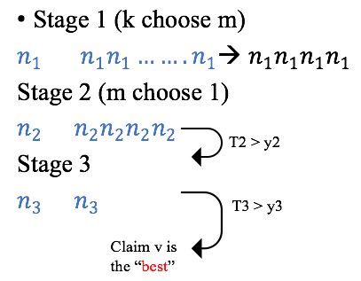
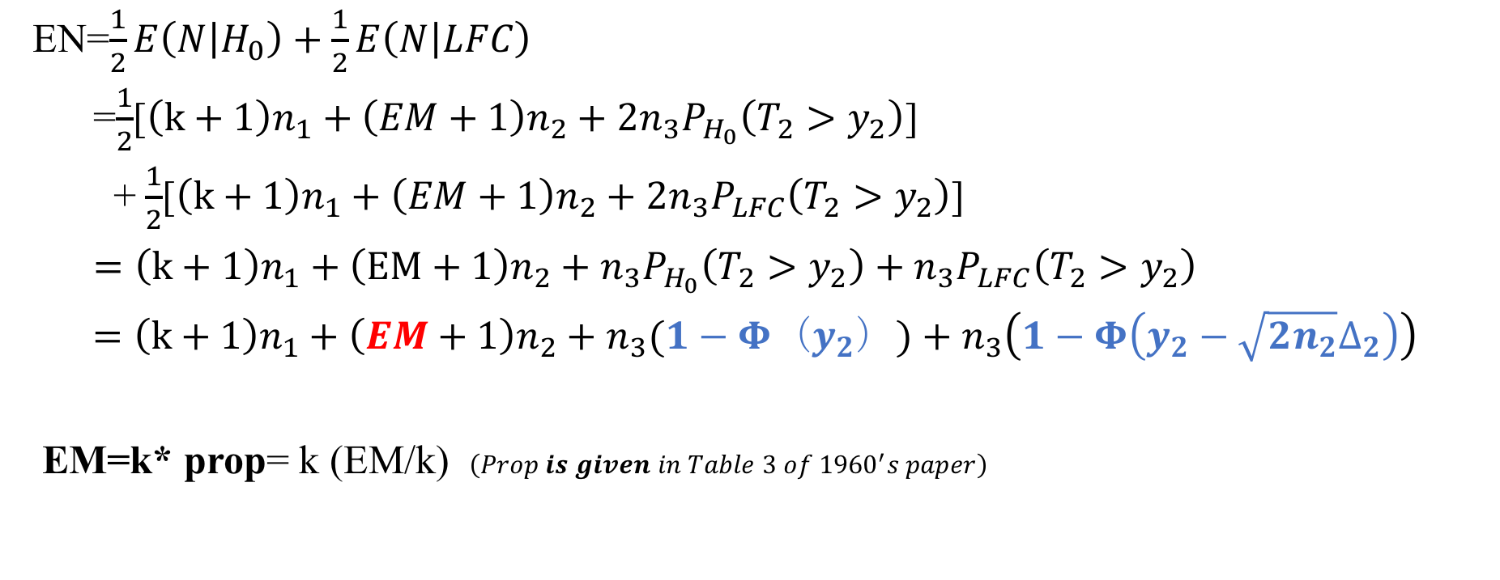
EN=$\frac{1}{2}E\left(N | H_{0}\right)+\frac{1}{2}E\left(N | LFC\right)$
=$\frac{1}{2}$[$\left(k+1\right)n_{1}+\left(EM+1\right)n_{2}+{2n}_{3}P_{H_{0}}\left(T_{2}>y_{2}\right)$]
+$\frac{1}{2}$[$\left(k+1\right)n_{1}+\left(EM+1\right)n_{2}+{2n}_{3}P_{LFC}\left(T_{2}>y_{2}\right)$]
$=\left(k+1\right)n_{1}+\left(EM+1\right)n_{2}+n_{3}P_{H_{0}}\left(T_{2}>y_{2}\right)+n_{3}P_{LFC}\left(T_{2}>y_{2}\right)$
$=\left(k+1\right)n_{1}+\left(EM+1\right)n_{2}+n_{3}(1−Φ（y_{2}）)+n_{3}\left(1−Φ（y_{2}−{\sqrt{2n_{2}}∆}_{2}）\right)$
EM=k* prop= k (EM/k) $\left(Prop is given in Table 3 of {1960}^{′}s paper\right)$
Notes:
The only unknown part is the EM part, What we did is to compute it as k times the proportion of EM over k, this ratio is given in table 3 in Gupta and Sobel’s paper， so once we assign a power for the first stage ,this number is just a constant.
however, once we specify a number in the table, we are at the same time fixing k, delta, and P1. this is a very good thing, so in our analysis part, we took use of such relation, and all these variables are pre assigned at the same time.

Slide 16
Minimize EN= s.t. P(CS)= $α$ =
$$(k{+1)n}_{1}+\left(EM+1\right)n_{2}+n_{3}\left(1−Φ（y_{2}）\right)+n_{3}\left(1−Φ（y_{2}−{\sqrt{2n_{2}}∆}_{2}）\right) , where EM=Prop∗k$$

Slide 17
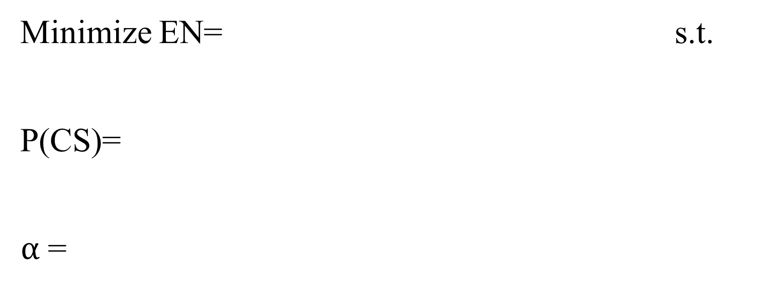
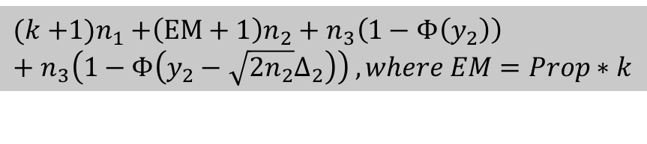
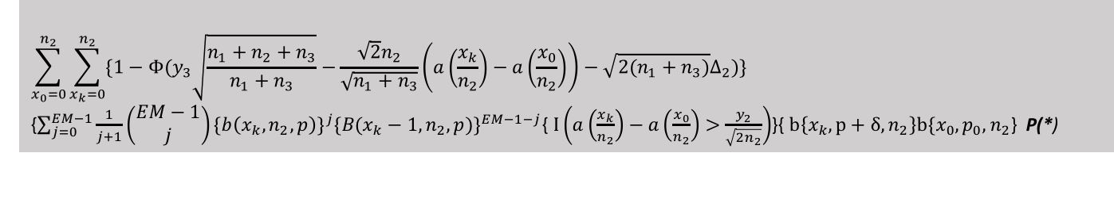
Minimize EN= s.t. P(CS)= $α$ =
$$(k{+1)n}_{1}+\left(EM+1\right)n_{2}+n_{3}\left(1−Φ（y_{2}）\right)+n_{3}\left(1−Φ（y_{2}−{\sqrt{2n_{2}}∆}_{2}）\right) , where EM=Prop∗k$$
$$\sum_{x_{0}=0}^{n_{2}}{\sum_{x_{k}=0}^{n_{2}}{\{1−Φ(y_{3}\sqrt{\frac{n_{1}+n_{2}+n_{3}}{n_{1}+n_{3}}}−\frac{{\sqrt{2}n}_{2}}{\sqrt{n_{1}+n_{3}}}\left(a\left(\frac{x_{k}}{n_{2}}\right)−a\left(\frac{x_{0}}{n_{2}}\right)\right)−\sqrt{2\left(n_{1}+n_{3}\right)}∆_{2})\} }}$$
{$\sum_{j=0}^{EM−1}{\frac{1}{j+1}\left(\begin{matrix}EM−1 \\ j\end{matrix}\right){\{b\left(x_{k},n_{2},p\right)\}}^{j}{\{B(x_{k}−1,n_{2},p)\}}^{EM−1−j}}${$I\left(a\left(\frac{x_{k}}{n_{2}}\right)−a\left(\frac{x_{0}}{n_{2}}\right)>\frac{y_{2}}{\sqrt{2n_{2}}}\right)$}{$b\left\{x_{k},p+δ,n_{2}\right\}b\{x_{0},p_{0},n_{2}$} P(*)
Notes:
Instead of showing the tedious proof, I really want to explain the logic of writing this formula. Power p(cs) is defined as the probability that the best treatment is selected under lfc.

Slide 18
Stage 1 (k choose m)
| |||||||→ ||||
Stage 2 (m choose 1)
| ||||
Stage 3
| |
PCS(subset selection):=P(*)
P(stage 1 → 2)=1
P(stage 2→ 3)=P(T2 > y2)
P(M): randomization among j+1 ties
P(“best v” selected)=P(T3 > y3)
T2 > y2
T3 > y3
Claim v is the “best”
Notes:
Def of power is that this indi passed all three procedures under this configuration.

Slide 19
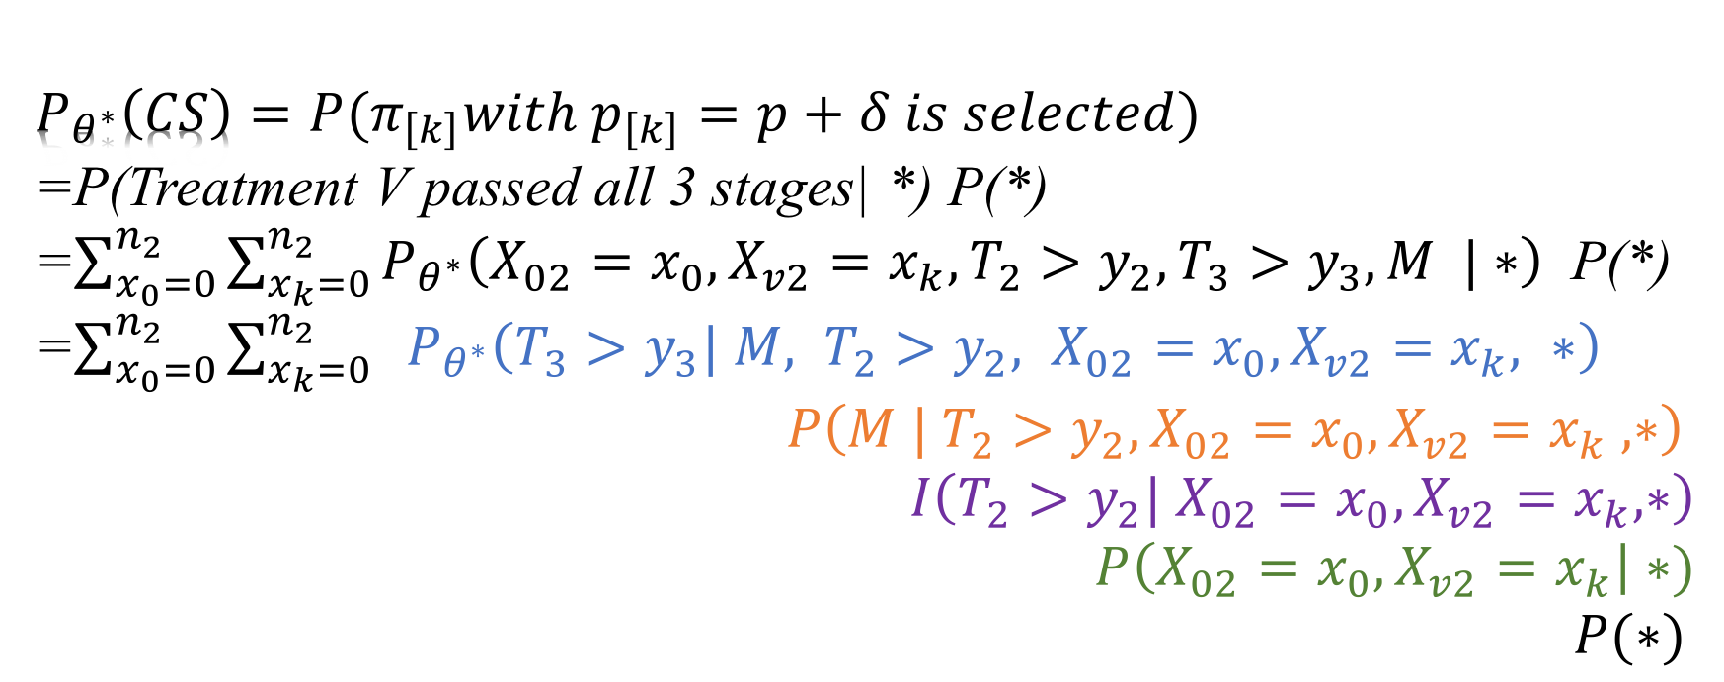
$$P_{θ^{∗}}\left(CS\right)=P(π_{\left[k\right]}with p_{\left[k\right]}=p+δ is selected)$$
=P(Treatment V passed all 3 stages| *) P(*)
=$\sum_{x_{0}=0}^{n_{2}}{\sum_{x_{k}=0}^{n_{2}}{P_{θ^{∗}}\left(X_{02}=x_{0},X_{v2}=x_{k}, T_{2}>y_{2},T_{3}>y_{3}, M |∗\right)} }$ P(*)
=$\sum_{x_{0}=0}^{n_{2}}{\sum_{x_{k}=0}^{n_{2}}{{ P}_{θ^{∗}}\left(T_{3}>y_{3}| M, {T_{2}>y_{2}, X}_{02}=x_{0},X_{v2}=x_{k}, ∗\right)} }$
$$P\left(M | {T_{2}>y_{2}, X}_{02}=x_{0},X_{v2}=x_{k} , ∗\right)$$
$$I\left(T_{2}>y_{2}| X_{02}=x_{0},X_{v2}=x_{k}, ∗\right)$$
$$P\left(X_{02}=x_{0},X_{v2}=x_{k}\right|∗)$$
$P(∗)$
Notes:
Now to write everything into a formula, we need to write in a bottom up order. These two x values in the outer summation are defined to be the sample mean of the control at stge 2, and the sample mean of v at stage 2.

Slide 20
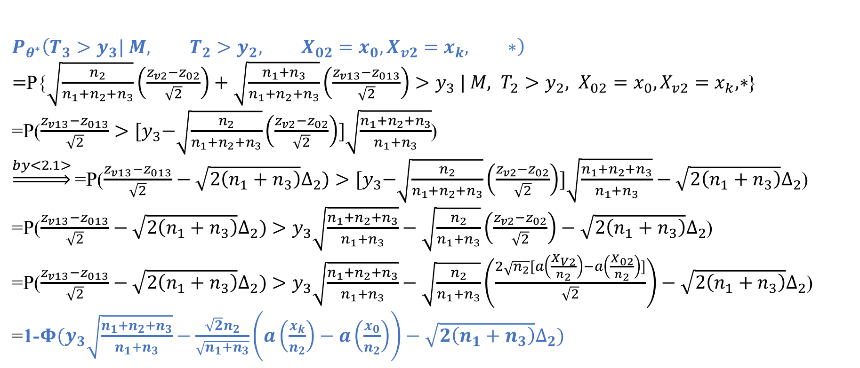
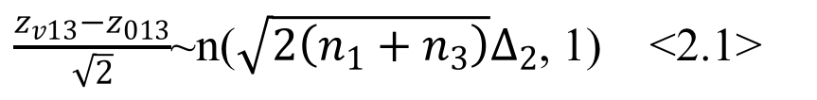
$\frac{z_{v13}−z_{013}}{\sqrt{2}}$~n($\sqrt{2\left(n_{1}+n_{3}\right)}∆_{2}$, 1) <2.1>
$$P_{θ^{∗}}\left(T_{3}>y_{3}| M, {T_{2}>y_{2}, X}_{02}=x_{0},X_{v2}=x_{k}, ∗\right)$$
$=$P{$\sqrt{\frac{n_{2}}{n_{1}+n_{2}+n_{3}}}\left(\frac{z_{v2}−z_{02}}{\sqrt{2}}\right)+\sqrt{\frac{n_{1}+n_{3}}{n_{1}+n_{2}+n_{3}}}\left(\frac{z_{v13}−z_{013}}{\sqrt{2}}\right)>y_{3} | M, {T_{2}>y_{2}, X}_{02}=x_{0},X_{v2}=x_{k}, ∗$}
=P($\frac{z_{v13}−z_{013}}{\sqrt{2}}>{[y}_{3}−\sqrt{\frac{n_{2}}{n_{1}+n_{2}+n_{3}}}\left(\frac{z_{v2}−z_{02}}{\sqrt{2}}\right)]\sqrt{\frac{n_{1}+n_{2}+n_{3}}{n_{1}+n_{3}}}$)
$\underset{⇒}{by<2.1>}$=P($\frac{z_{v13}−z_{013}}{\sqrt{2}}−\sqrt{2\left(n_{1}+n_{3}\right)}∆_{2})>{[y}_{3}−\sqrt{\frac{n_{2}}{n_{1}+n_{2}+n_{3}}}\left(\frac{z_{v2}−z_{02}}{\sqrt{2}}\right)]\sqrt{\frac{n_{1}+n_{2}+n_{3}}{n_{1}+n_{3}}}−\sqrt{2\left(n_{1}+n_{3}\right)}∆_{2}$)
=P($\frac{z_{v13}−z_{013}}{\sqrt{2}}−\sqrt{2\left(n_{1}+n_{3}\right)}∆_{2})>y_{3}\sqrt{\frac{n_{1}+n_{2}+n_{3}}{n_{1}+n_{3}}}−\sqrt{\frac{n_{2}}{n_{1}+n_{3}}}\left(\frac{z_{v2}−z_{02}}{\sqrt{2}}\right)−\sqrt{2\left(n_{1}+n_{3}\right)}∆_{2}$)
=P($\frac{z_{v13}−z_{013}}{\sqrt{2}}−\sqrt{2\left(n_{1}+n_{3}\right)}∆_{2})>y_{3}\sqrt{\frac{n_{1}+n_{2}+n_{3}}{n_{1}+n_{3}}}−\sqrt{\frac{n_{2}}{n_{1}+n_{3}}}\left(\frac{2\sqrt{n_{2}}[a\left(\frac{X_{V2}}{n_{2}}\right)−a\left(\frac{X_{02}}{n_{2}}\right)]}{\sqrt{2}}\right)−\sqrt{2\left(n_{1}+n_{3}\right)}∆_{2}$)
=1-$Φ(y_{3}\sqrt{\frac{n_{1}+n_{2}+n_{3}}{n_{1}+n_{3}}}−\frac{{\sqrt{2}n}_{2}}{\sqrt{n_{1}+n_{3}}}\left(a\left(\frac{x_{k}}{n_{2}}\right)−a\left(\frac{x_{0}}{n_{2}}\right)\right)−\sqrt{2\left(n_{1}+n_{3}\right)}∆_{2})$

Slide 21
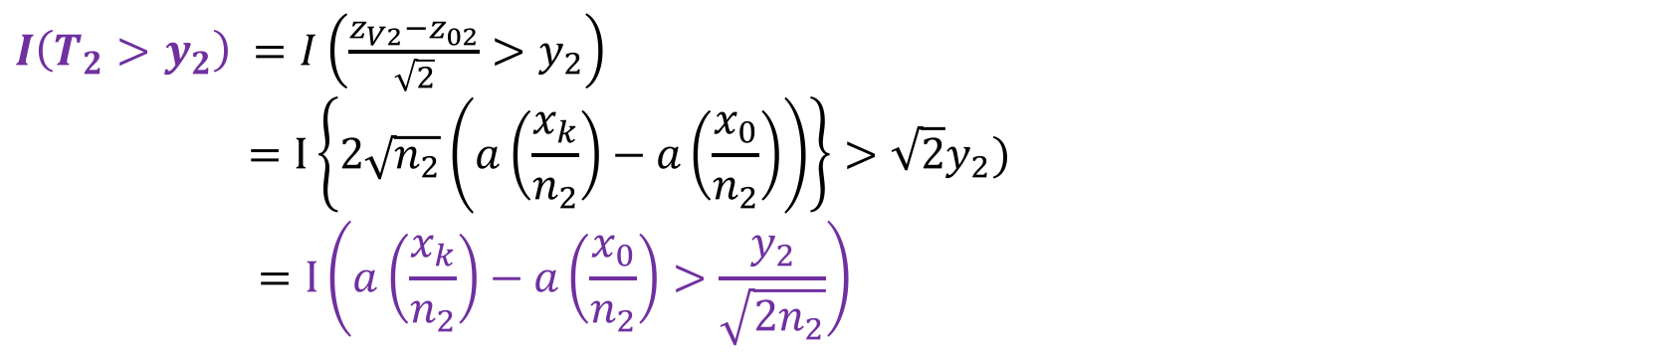
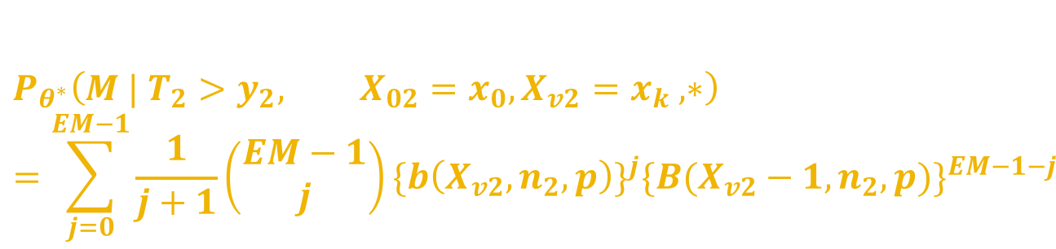
$$P_{θ^{∗}}\left(M | {T_{2}>y_{2}, X}_{02}=x_{0},X_{v2}=x_{k} , ∗\right)$$
$$=\sum_{j=0}^{EM−1}{\frac{1}{j+1}\left(\begin{matrix}EM−1 \\ j\end{matrix}\right){\{b\left(X_{v2},n_{2},p\right)\}}^{j}{\{B(X_{v2}−1,n_{2},p)\}}^{EM−1−j}}$$
$I\left(T_{2}>y_{2}\right)$ $=I\left(\frac{z_{V2}−z_{02}}{\sqrt{2}}>y_{2}\right)$
$$=I\left\{2\sqrt{n_{2}}\left(a\left(\frac{x_{k}}{n_{2}}\right)−a\left(\frac{x_{0}}{n_{2}}\right)\right)\right\}>\sqrt{2}y_{2})$$
$$=I\left(a\left(\frac{x_{k}}{n_{2}}\right)−a\left(\frac{x_{0}}{n_{2}}\right)>\frac{y_{2}}{\sqrt{2n_{2}}}\right)$$
$P\left(X_{02}=x_{0},X_{v2}=x_{k}\right|∗)$=$b\left\{x_{k},p+δ,n_{2}\right\}b\{x_{0},p_{0},n_{2}\}$

Slide 22
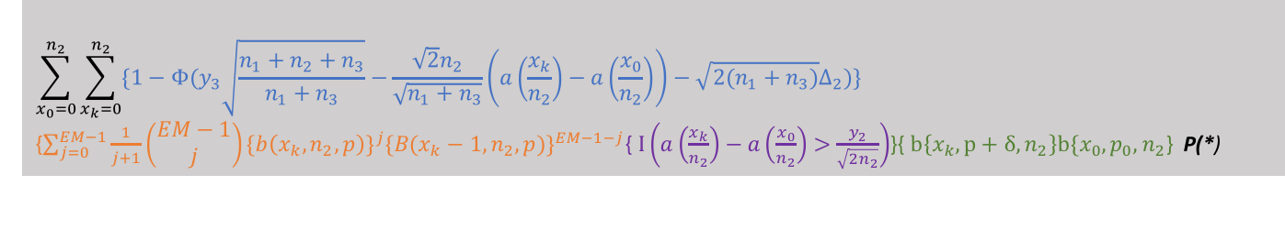
Minimize EN= s.t. P(CS)= $α$ =
$$(k{+1)n}_{1}+\left(EM+1\right)n_{2}+n_{3}\left(1−Φ（y_{2}）\right)+n_{3}\left(1−Φ（y_{2}−{\sqrt{2n_{2}}∆}_{2}）\right) , where EM=Prop∗k$$
$$\sum_{x_{0}=0}^{n_{2}}{\sum_{x_{k}=0}^{n_{2}}{\{1−Φ(y_{3}\sqrt{\frac{n_{1}+n_{2}+n_{3}}{n_{1}+n_{3}}}−\frac{{\sqrt{2}n}_{2}}{\sqrt{n_{1}+n_{3}}}\left(a\left(\frac{x_{k}}{n_{2}}\right)−a\left(\frac{x_{0}}{n_{2}}\right)\right)−\sqrt{2\left(n_{1}+n_{3}\right)}∆_{2})\} }}$$
{$\sum_{j=0}^{EM−1}{\frac{1}{j+1}\left(\begin{matrix}EM−1 \\ j\end{matrix}\right){\{b\left(x_{k},n_{2},p\right)\}}^{j}{\{B(x_{k}−1,n_{2},p)\}}^{EM−1−j}}${$I\left(a\left(\frac{x_{k}}{n_{2}}\right)−a\left(\frac{x_{0}}{n_{2}}\right)>\frac{y_{2}}{\sqrt{2n_{2}}}\right)$}{$b\left\{x_{k},p+δ,n_{2}\right\}b\{x_{0},p_{0},n_{2}$} P(*)

Slide 23
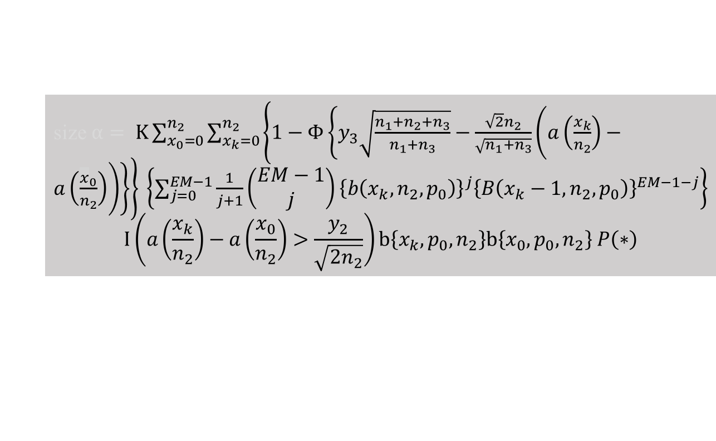
Minimize EN= s.t. P(CS)= $α$ =
$$(k{+1)n}_{1}+\left(EM+1\right)n_{2}+n_{3}\left(1−Φ（y_{2}）\right)+n_{3}\left(1−Φ（y_{2}−{\sqrt{2n_{2}}∆}_{2}）\right) , where EM=Prop∗k$$
$$\sum_{x_{0}=0}^{n_{2}}{\sum_{x_{k}=0}^{n_{2}}{\{1−Φ(y_{3}\sqrt{\frac{n_{1}+n_{2}+n_{3}}{n_{1}+n_{3}}}−\frac{{\sqrt{2}n}_{2}}{\sqrt{n_{1}+n_{3}}}\left(a\left(\frac{x_{k}}{n_{2}}\right)−a\left(\frac{x_{0}}{n_{2}}\right)\right)−\sqrt{2\left(n_{1}+n_{3}\right)}∆_{2})\} }}$$
{$\sum_{j=0}^{EM−1}{\frac{1}{j+1}\left(\begin{matrix}EM−1 \\ j\end{matrix}\right){\{b\left(x_{k},n_{2},p\right)\}}^{j}{\{B(x_{k}−1,n_{2},p)\}}^{EM−1−j}}${$I\left(a\left(\frac{x_{k}}{n_{2}}\right)−a\left(\frac{x_{0}}{n_{2}}\right)>\frac{y_{2}}{\sqrt{2n_{2}}}\right)$}{$b\left\{x_{k},p+δ,n_{2}\right\}b\{x_{0},p_{0},n_{2}$} P(*)
size $α= K\sum_{x_{0}=0}^{n_{2}}{\sum_{x_{k}=0}^{n_{2}}{\left\{1−Φ\left\{y_{3}\sqrt{\frac{n_{1}+n_{2}+n_{3}}{n_{1}+n_{3}}}−\frac{\sqrt{2}n_{2}}{\sqrt{n_{1}+n_{3}}}\left(a\left(\frac{x_{k}}{n_{2}}\right)−a\left(\frac{x_{0}}{n_{2}}\right)\right)\right\}\right\}} }\left\{\sum_{j=0}^{EM−1}{\frac{1}{j+1}\left(\begin{matrix}EM−1 \\ j\end{matrix}\right){\left\{b\left(x_{k},n_{2},p_{0}\right)\right\}}^{j}{\left\{B\left(x_{k}−1,n_{2},p_{0}\right)\right\}}^{EM−1−j}}\right\}$
$$I\left(a\left(\frac{x_{k}}{n_{2}}\right)−a\left(\frac{x_{0}}{n_{2}}\right)>\frac{y_{2}}{\sqrt{2n_{2}}}\right)b\left\{x_{k},p_{0},n_{2}\right\}b\left\{x_{0},p_{0},n_{2}\right\} P\left(∗\right)$$
Notes:
Alpha is the type 1 err,

Slide 24
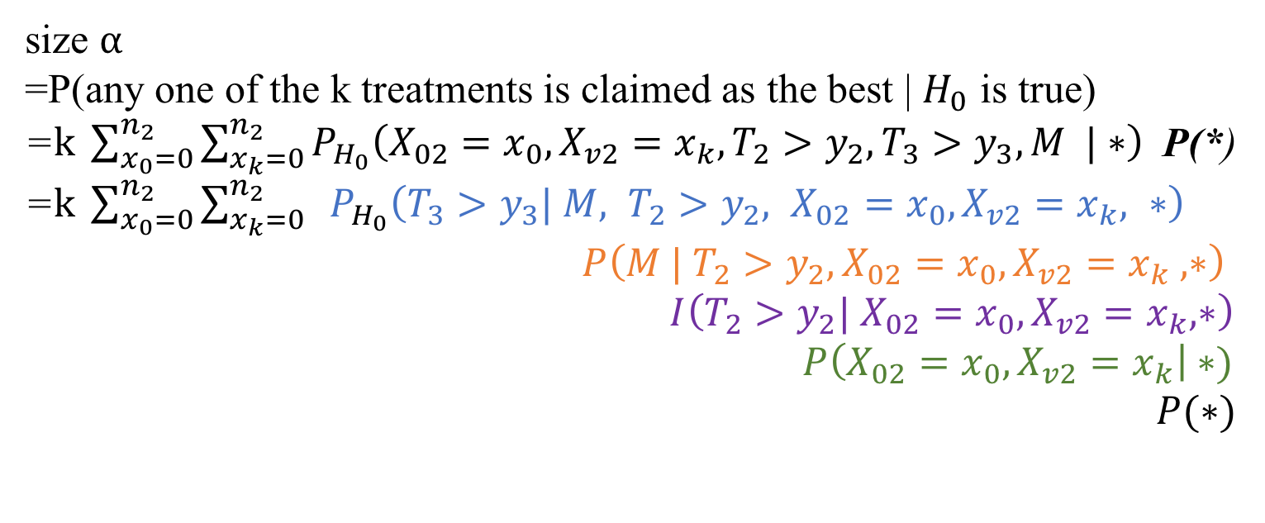
size $α$
=P(any one of the k treatments is claimed as the best | $H_{0}$ is true)
=$k \sum_{x_{0}=0}^{n_{2}}{\sum_{x_{k}=0}^{n_{2}}{P_{H_{0}}\left(X_{02}=x_{0},X_{v2}=x_{k}, T_{2}>y_{2},T_{3}>y_{3}, M |∗\right)} }$ P(*)
=$k \sum_{x_{0}=0}^{n_{2}}{\sum_{x_{k}=0}^{n_{2}}{{ P}_{H_{0}}\left(T_{3}>y_{3}| M, {T_{2}>y_{2}, X}_{02}=x_{0},X_{v2}=x_{k}, ∗\right)} }$
$$P\left(M | {T_{2}>y_{2}, X}_{02}=x_{0},X_{v2}=x_{k} , ∗\right)$$
$$I\left(T_{2}>y_{2}| X_{02}=x_{0},X_{v2}=x_{k}, ∗\right)$$
$$P\left(X_{02}=x_{0},X_{v2}=x_{k}\right|∗)$$
$P(∗)$

Slide 25
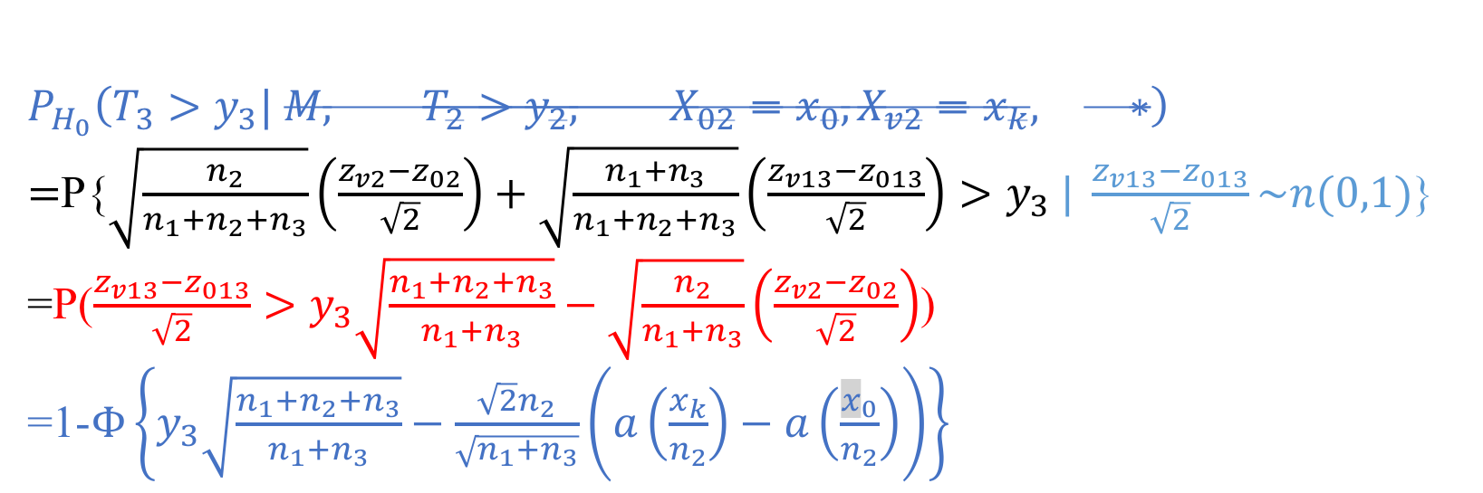
$$P_{H_{0}}\left(T_{3}>y_{3}| M, {T_{2}>y_{2}, X}_{02}=x_{0},X_{v2}=x_{k}, ∗\right)$$
$=$P{$\sqrt{\frac{n_{2}}{n_{1}+n_{2}+n_{3}}}\left(\frac{z_{v2}−z_{02}}{\sqrt{2}}\right)+\sqrt{\frac{n_{1}+n_{3}}{n_{1}+n_{2}+n_{3}}}\left(\frac{z_{v13}−z_{013}}{\sqrt{2}}\right)>y_{3} | \frac{z_{v13}−z_{013}}{\sqrt{2}}\sim n(0,1)$}
=P($\frac{z_{v13}−z_{013}}{\sqrt{2}}>y_{3}\sqrt{\frac{n_{1}+n_{2}+n_{3}}{n_{1}+n_{3}}}−\sqrt{\frac{n_{2}}{n_{1}+n_{3}}}\left(\frac{z_{v2}−z_{02}}{\sqrt{2}}\right)$)
=1-$Φ\left\{y_{3}\sqrt{\frac{n_{1}+n_{2}+n_{3}}{n_{1}+n_{3}}}−\frac{\sqrt{2}n_{2}}{\sqrt{n_{1}+n_{3}}}\left(a\left(\frac{x_{k}}{n_{2}}\right)−a\left(\frac{x_{0}}{n_{2}}\right)\right)\right\}$

Slide 26
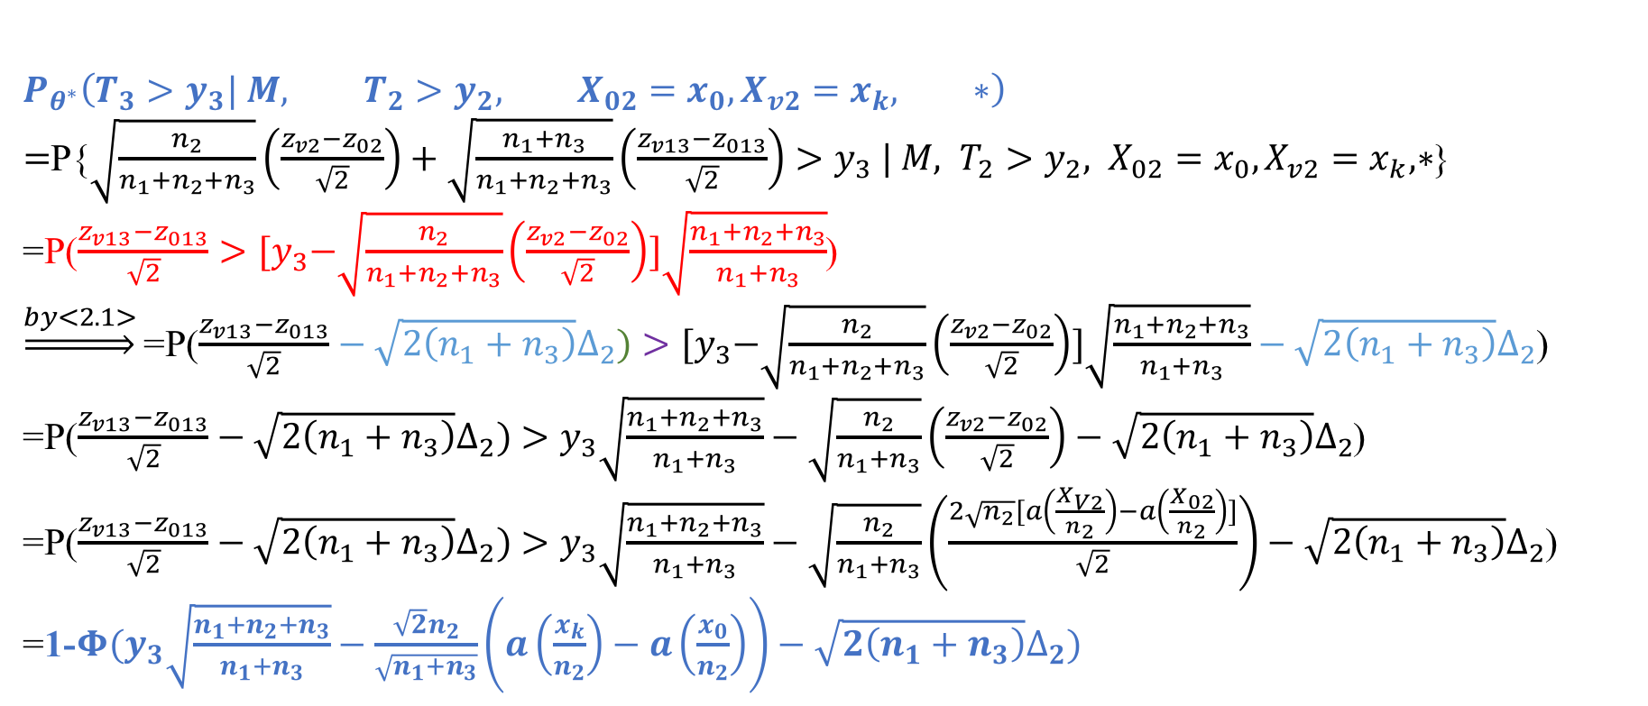
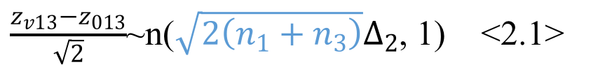
$\frac{z_{v13}−z_{013}}{\sqrt{2}}$~n($\sqrt{2\left(n_{1}+n_{3}\right)}∆_{2}$, 1) <2.1>
$$P_{θ^{∗}}\left(T_{3}>y_{3}| M, {T_{2}>y_{2}, X}_{02}=x_{0},X_{v2}=x_{k}, ∗\right)$$
$=$P{$\sqrt{\frac{n_{2}}{n_{1}+n_{2}+n_{3}}}\left(\frac{z_{v2}−z_{02}}{\sqrt{2}}\right)+\sqrt{\frac{n_{1}+n_{3}}{n_{1}+n_{2}+n_{3}}}\left(\frac{z_{v13}−z_{013}}{\sqrt{2}}\right)>y_{3} | M, {T_{2}>y_{2}, X}_{02}=x_{0},X_{v2}=x_{k}, ∗$}
=P($\frac{z_{v13}−z_{013}}{\sqrt{2}}>{[y}_{3}−\sqrt{\frac{n_{2}}{n_{1}+n_{2}+n_{3}}}\left(\frac{z_{v2}−z_{02}}{\sqrt{2}}\right)]\sqrt{\frac{n_{1}+n_{2}+n_{3}}{n_{1}+n_{3}}}$)
$\underset{⇒}{by<2.1>}$=P($\frac{z_{v13}−z_{013}}{\sqrt{2}}−\sqrt{2\left(n_{1}+n_{3}\right)}∆_{2})>{[y}_{3}−\sqrt{\frac{n_{2}}{n_{1}+n_{2}+n_{3}}}\left(\frac{z_{v2}−z_{02}}{\sqrt{2}}\right)]\sqrt{\frac{n_{1}+n_{2}+n_{3}}{n_{1}+n_{3}}}−\sqrt{2\left(n_{1}+n_{3}\right)}∆_{2}$)
=P($\frac{z_{v13}−z_{013}}{\sqrt{2}}−\sqrt{2\left(n_{1}+n_{3}\right)}∆_{2})>y_{3}\sqrt{\frac{n_{1}+n_{2}+n_{3}}{n_{1}+n_{3}}}−\sqrt{\frac{n_{2}}{n_{1}+n_{3}}}\left(\frac{z_{v2}−z_{02}}{\sqrt{2}}\right)−\sqrt{2\left(n_{1}+n_{3}\right)}∆_{2}$)
=P($\frac{z_{v13}−z_{013}}{\sqrt{2}}−\sqrt{2\left(n_{1}+n_{3}\right)}∆_{2})>y_{3}\sqrt{\frac{n_{1}+n_{2}+n_{3}}{n_{1}+n_{3}}}−\sqrt{\frac{n_{2}}{n_{1}+n_{3}}}\left(\frac{2\sqrt{n_{2}}[a\left(\frac{X_{V2}}{n_{2}}\right)−a\left(\frac{X_{02}}{n_{2}}\right)]}{\sqrt{2}}\right)−\sqrt{2\left(n_{1}+n_{3}\right)}∆_{2}$)
=1-$Φ(y_{3}\sqrt{\frac{n_{1}+n_{2}+n_{3}}{n_{1}+n_{3}}}−\frac{{\sqrt{2}n}_{2}}{\sqrt{n_{1}+n_{3}}}\left(a\left(\frac{x_{k}}{n_{2}}\right)−a\left(\frac{x_{0}}{n_{2}}\right)\right)−\sqrt{2\left(n_{1}+n_{3}\right)}∆_{2})$

Slide 27
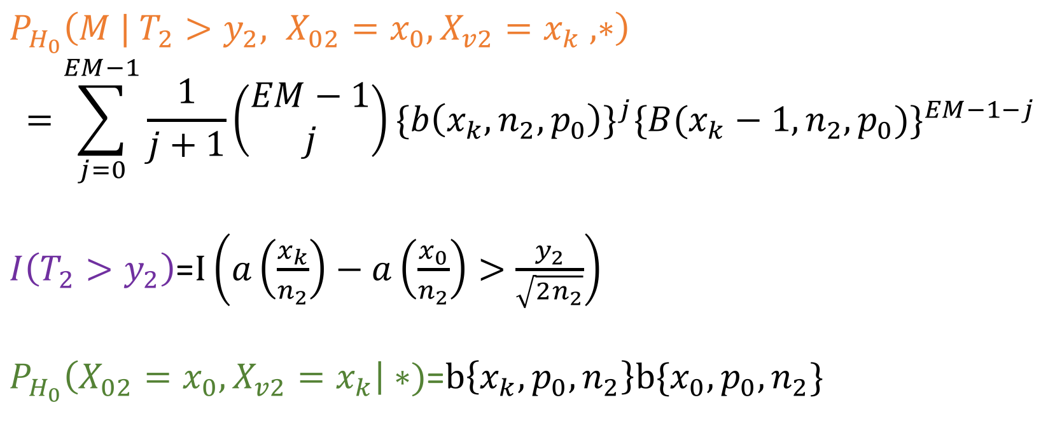
$P_{H_{0}}\left(M | {T_{2}>y_{2}, X}_{02}=x_{0},X_{v2}=x_{k} , ∗\right)$
$$=\sum_{j=0}^{EM−1}{\frac{1}{j+1}\left(\begin{matrix}EM−1 \\ j\end{matrix}\right){\{b\left(x_{k},n_{2},p_{0}\right)\}}^{j}{\{B(x_{k}−1,n_{2},p_{0})\}}^{EM−1−j}}$$
$I\left(T_{2}>y_{2}\right)$=$I\left(a\left(\frac{x_{k}}{n_{2}}\right)−a\left(\frac{x_{0}}{n_{2}}\right)>\frac{y_{2}}{\sqrt{2n_{2}}}\right)$
$P_{H_{0}}\left(X_{02}=x_{0},X_{v2}=x_{k}\right|∗)$=$b\left\{x_{k},p_{0},n_{2}\right\}b\{x_{0},p_{0},n_{2}\}$

Slide 28


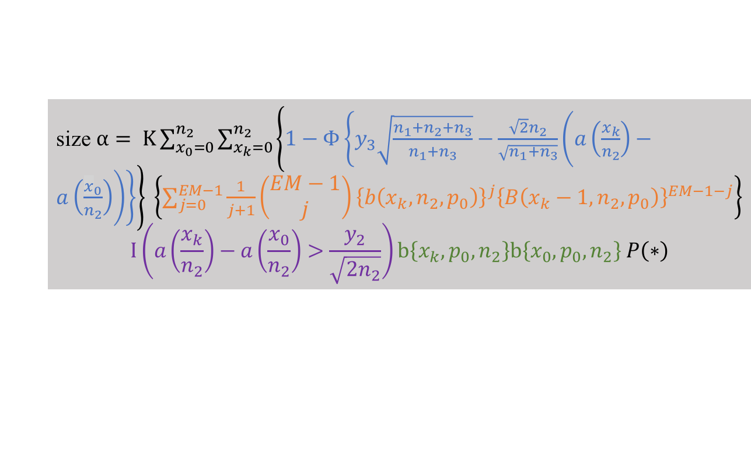
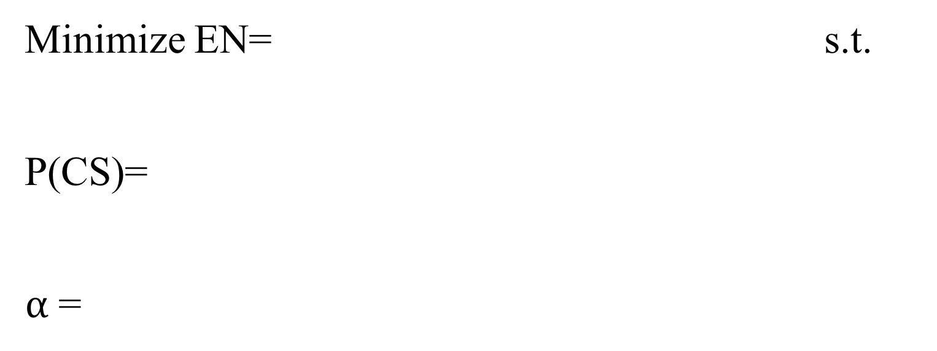
Minimize EN= s.t. P(CS)= $α$ =
$$(k{+1)n}_{1}+\left(EM+1\right)n_{2}+n_{3}\left(1−Φ（y_{2}）\right)+n_{3}\left(1−Φ（y_{2}−{\sqrt{2n_{2}}∆}_{2}）\right) , where EM=Prop∗k$$
$$\sum_{x_{0}=0}^{n_{2}}{\sum_{x_{k}=0}^{n_{2}}{\{1−Φ(y_{3}\sqrt{\frac{n_{1}+n_{2}+n_{3}}{n_{1}+n_{3}}}−\frac{{\sqrt{2}n}_{2}}{\sqrt{n_{1}+n_{3}}}\left(a\left(\frac{x_{k}}{n_{2}}\right)−a\left(\frac{x_{0}}{n_{2}}\right)\right)−\sqrt{2\left(n_{1}+n_{3}\right)}∆_{2})\} }}$$
{$\sum_{j=0}^{EM−1}{\frac{1}{j+1}\left(\begin{matrix}EM−1 \\ j\end{matrix}\right){\{b\left(x_{k},n_{2},p\right)\}}^{j}{\{B(x_{k}−1,n_{2},p)\}}^{EM−1−j}}${$I\left(a\left(\frac{x_{k}}{n_{2}}\right)−a\left(\frac{x_{0}}{n_{2}}\right)>\frac{y_{2}}{\sqrt{2n_{2}}}\right)$}{$b\left\{x_{k},p+δ,n_{2}\right\}b\{x_{0},p_{0},n_{2}$} P(*)
size $α= K\sum_{x_{0}=0}^{n_{2}}{\sum_{x_{k}=0}^{n_{2}}{\left\{1−Φ\left\{y_{3}\sqrt{\frac{n_{1}+n_{2}+n_{3}}{n_{1}+n_{3}}}−\frac{\sqrt{2}n_{2}}{\sqrt{n_{1}+n_{3}}}\left(a\left(\frac{x_{k}}{n_{2}}\right)−a\left(\frac{x_{0}}{n_{2}}\right)\right)\right\}\right\}} }\left\{\sum_{j=0}^{EM−1}{\frac{1}{j+1}\left(\begin{matrix}EM−1 \\ j\end{matrix}\right){\left\{b\left(x_{k},n_{2},p_{0}\right)\right\}}^{j}{\left\{B\left(x_{k}−1,n_{2},p_{0}\right)\right\}}^{EM−1−j}}\right\}$
$$I\left(a\left(\frac{x_{k}}{n_{2}}\right)−a\left(\frac{x_{0}}{n_{2}}\right)>\frac{y_{2}}{\sqrt{2n_{2}}}\right)b\left\{x_{k},p_{0},n_{2}\right\}b\left\{x_{0},p_{0},n_{2}\right\} P\left(∗\right)$$

Slide 29
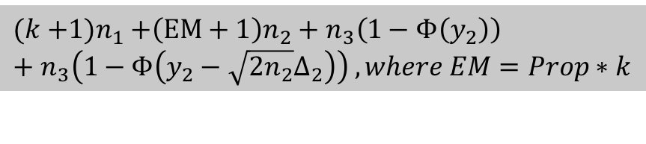
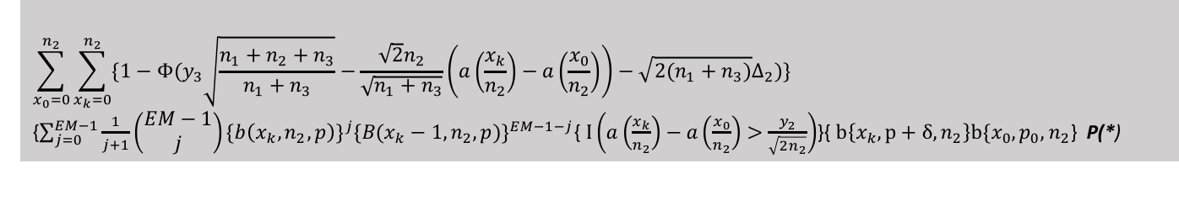

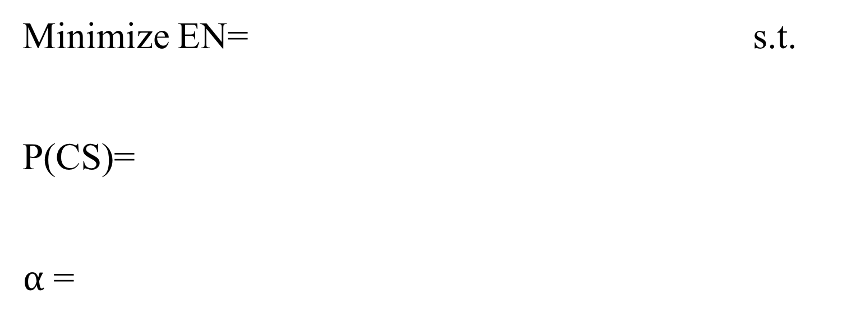
Minimize EN= s.t. P(CS)= $α$ =
$$(k{+1)n}_{1}+\left(EM+1\right)n_{2}+n_{3}\left(1−Φ（y_{2}）\right)+n_{3}\left(1−Φ（y_{2}−{\sqrt{2n_{2}}∆}_{2}）\right) , where EM=Prop∗k$$
$$\sum_{x_{0}=0}^{n_{2}}{\sum_{x_{k}=0}^{n_{2}}{\{1−Φ(y_{3}\sqrt{\frac{n_{1}+n_{2}+n_{3}}{n_{1}+n_{3}}}−\frac{{\sqrt{2}n}_{2}}{\sqrt{n_{1}+n_{3}}}\left(a\left(\frac{x_{k}}{n_{2}}\right)−a\left(\frac{x_{0}}{n_{2}}\right)\right)−\sqrt{2\left(n_{1}+n_{3}\right)}∆_{2})\} }}$$
{$\sum_{j=0}^{EM−1}{\frac{1}{j+1}\left(\begin{matrix}EM−1 \\ j\end{matrix}\right){\{b\left(x_{k},n_{2},p\right)\}}^{j}{\{B(x_{k}−1,n_{2},p)\}}^{EM−1−j}}${$I\left(a\left(\frac{x_{k}}{n_{2}}\right)−a\left(\frac{x_{0}}{n_{2}}\right)>\frac{y_{2}}{\sqrt{2n_{2}}}\right)$}{$b\left\{x_{k},p+δ,n_{2}\right\}b\{x_{0},p_{0},n_{2}$} P(*)
size $α= K\sum_{x_{0}=0}^{n_{2}}{\sum_{x_{k}=0}^{n_{2}}{\left\{1−Φ\left\{y_{3}\sqrt{\frac{n_{1}+n_{2}+n_{3}}{n_{1}+n_{3}}}−\frac{\sqrt{2}n_{2}}{\sqrt{n_{1}+n_{3}}}\left(a\left(\frac{x_{k}}{n_{2}}\right)−a\left(\frac{x_{0}}{n_{2}}\right)\right)\right\}\right\}} }\left\{\sum_{j=0}^{EM−1}{\frac{1}{j+1}\left(\begin{matrix}EM−1 \\ j\end{matrix}\right){\left\{b\left(x_{k},n_{2},p_{0}\right)\right\}}^{j}{\left\{B\left(x_{k}−1,n_{2},p_{0}\right)\right\}}^{EM−1−j}}\right\}$
$$I\left(a\left(\frac{x_{k}}{n_{2}}\right)−a\left(\frac{x_{0}}{n_{2}}\right)>\frac{y_{2}}{\sqrt{2n_{2}}}\right)b\left\{x_{k},p_{0},n_{2}\right\}b\left\{x_{0},p_{0},n_{2}\right\} P\left(∗\right)$$

Slide 30
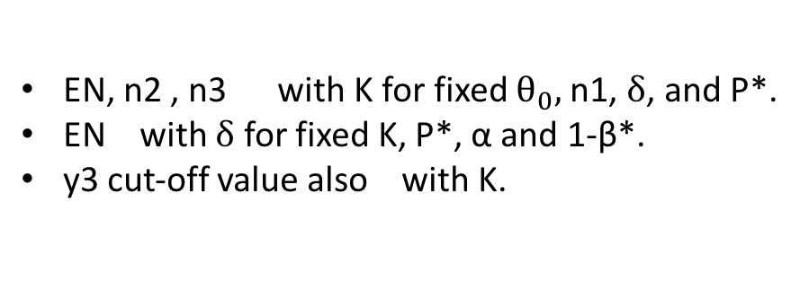
Numerical Result
$$δ$$ | 0.25 |  |  | 0.5
$$δ_{1}$$ | 0.1 |  |  | 0.05
$$δ_{2}$$ | 0.35 |  |  | 0.55
$$θ_{0}$$ | 0.4 |  |  | 0.2
K | 3 |  | 5 | 3 | 5
Designs | 3-stage | 3-stage | 3-stage | 3-stage | 3-stage
y2 | 0.482 | 0.8 | 0.65 | 0.6 | 0.75
y3 | 1.9 | 1.9 | 2.03 | 2.08 | 2.18
n1 | 20 | 15 | 20 | 20 | 20
n2 | 34 | 38 | 35 | 50 | 55
n3 | 52 | 58 | 60 | 55 | 75
EN | 197 | 154 | 256 | 165 | 246
$$α$$ | 0.0479 | 0.04 | 0.0499 | 0.0493 | 0.0494
1-$β^{∗}$ | 0.92 | 0.883 | 0.910 | 0.95 | 0.95
p* | 0.95 | 0.9 | 0.95 | 0.95 | 0.95
Psub | 0.792 | 0.735 | 0.836 | 0.402 | 0.343
EN, n2 , n3 with K for fixed $θ_{0},$n1, $δ$, and P*.
EN with $δ$ for fixed K, P*, α and 1-β*.
y3 cut-off value also with K.

Slide 31
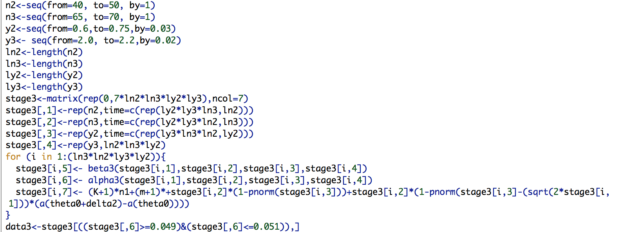

Slide 32
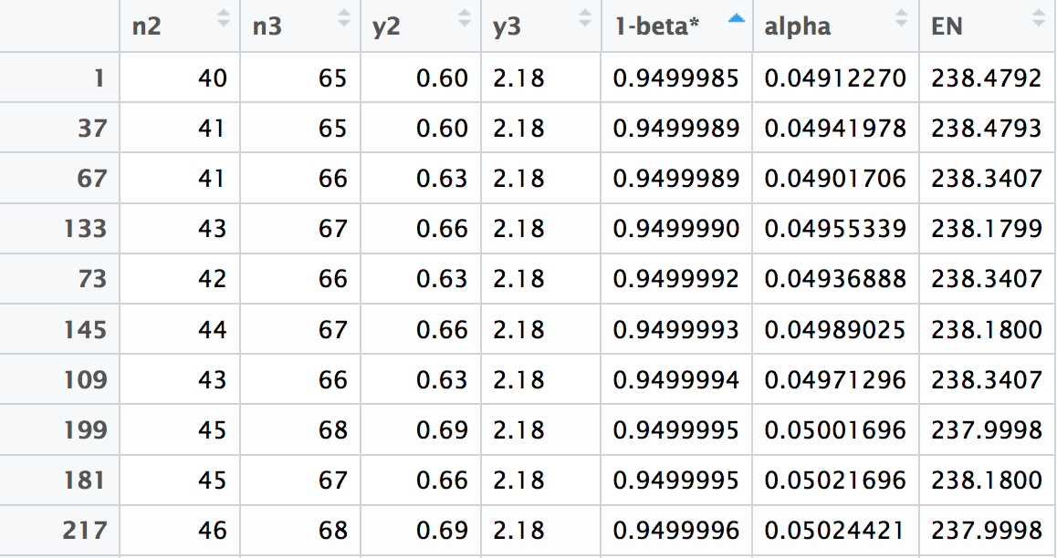

Slide 33
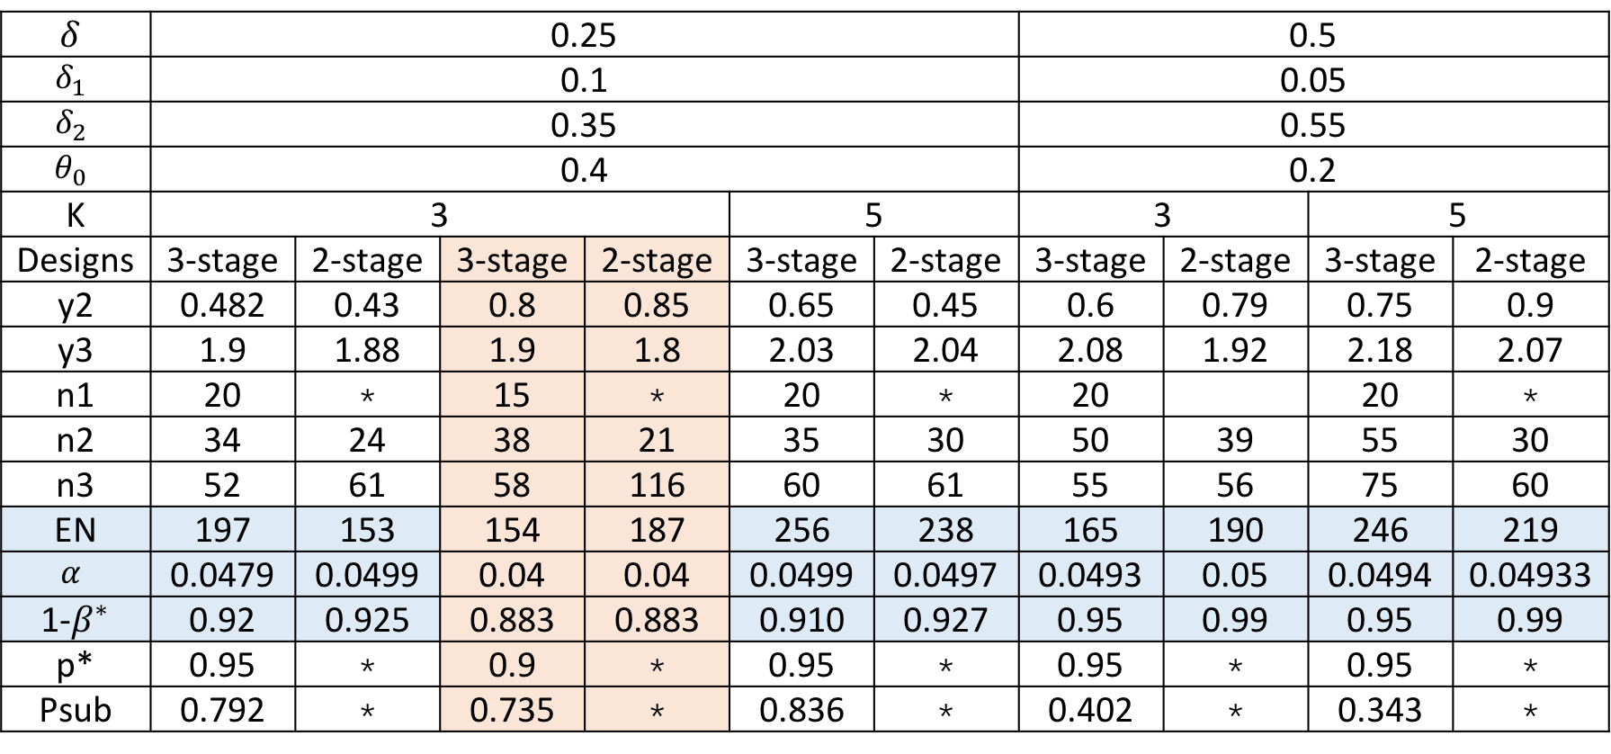
Numerical Result
$$δ$$ | 0.25 |  |  |  |  |  | 0.5
$$δ_{1}$$ | 0.1 |  |  |  |  |  | 0.05
$$δ_{2}$$ | 0.35 |  |  |  |  |  | 0.55
$$θ_{0}$$ | 0.4 |  |  |  |  |  | 0.2
K | 3 |  |  |  | 5 |  | 3 |  | 5
Designs | 3-stage | 2-stage | 3-stage | 2-stage | 3-stage | 2-stage | 3-stage | 2-stage | 3-stage | 2-stage
y2 | 0.482 | 0.43 | 0.8 | 0.85 | 0.65 | 0.45 | 0.6 | 0.79 | 0.75 | 0.9
y3 | 1.9 | 1.88 | 1.9 | 1.8 | 2.03 | 2.04 | 2.08 | 1.92 | 2.18 | 2.07
n1 | 20 | * | 15 | * | 20 | * | 20 |  | 20 | *
n2 | 34 | 24 | 38 | 21 | 35 | 30 | 50 | 39 | 55 | 30
n3 | 52 | 61 | 58 | 116 | 60 | 61 | 55 | 56 | 75 | 60
EN | 197 | 153 | 154 | 187 | 256 | 238 | 165 | 190 | 246 | 219
$$α$$ | 0.0479 | 0.0499 | 0.04 | 0.04 | 0.0499 | 0.0497 | 0.0493 | 0.05 | 0.0494 | 0.04933
1-$β^{∗}$ | 0.92 | 0.925 | 0.883 | 0.883 | 0.910 | 0.927 | 0.95 | 0.99 | 0.95 | 0.99
p* | 0.95 | * | 0.9 | * | 0.95 | * | 0.95 | * | 0.95 | *
Psub | 0.792 | * | 0.735 | * | 0.836 | * | 0.402 | * | 0.343 | *

Slide 34
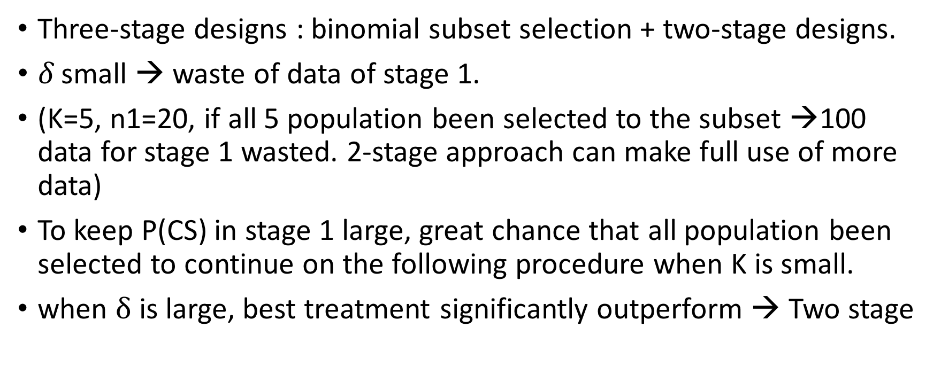
Summary
Three-stage designs : binomial subset selection + two-stage designs.
$δ$ small → waste of data of stage 1.
(K=5, n1=20, if all 5 population been selected to the subset →100 data for stage 1 wasted. 2-stage approach can make full use of more data)
To keep P(CS) in stage 1 large, great chance that all population been selected to continue on the following procedure when K is small.
when $δ$ is large, best treatment significantly outperform → Two stage

Slide 35
Thank You !

